Slide 1



j
iGaming Market Performance: Deposit, Bonus & Retention Insights
Special Projects Analyst — Interview Presentation
By Relebohile Masita

Slide 2

j
What This Analysis Covers
A market-by-market look at player activity, deposit value and bonus effectiveness across the iGaming platform, aimed at surfacing where value actually sits, not just where volume sits.
01 - Active Players by Market
Which countries generate the most active players
02 - Active Players by Product
Where casino, sports and live casino engagement concentrates
03 - Deposit Value by Market
Which markets produce the highest deposit value
04 - Bonus Effectiveness
Whether bonus spending improves deposit behaviour
05 - Turnover by Market
Where turnover is concentrated
06 - First-Time Depositor Value
Where new-player revenue is strongest

Slide 3
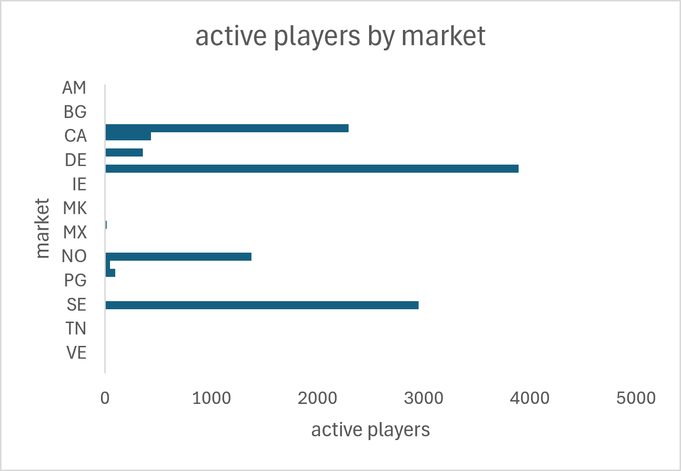
Which Countries Generate the Most Active Players
Key Insight:
Germany (DE) and Sweden (SE) dominate the active player base, at roughly 3,900 and 2,950 active players respectively, more than double Norway (NO), the next largest market.
The remaining markets each contribute under 500 active players.
Player activity is heavily
concentrated in two markets. Retention and engagement initiatives in DE and SE carry outsized impact on total platform activity.

Slide 4
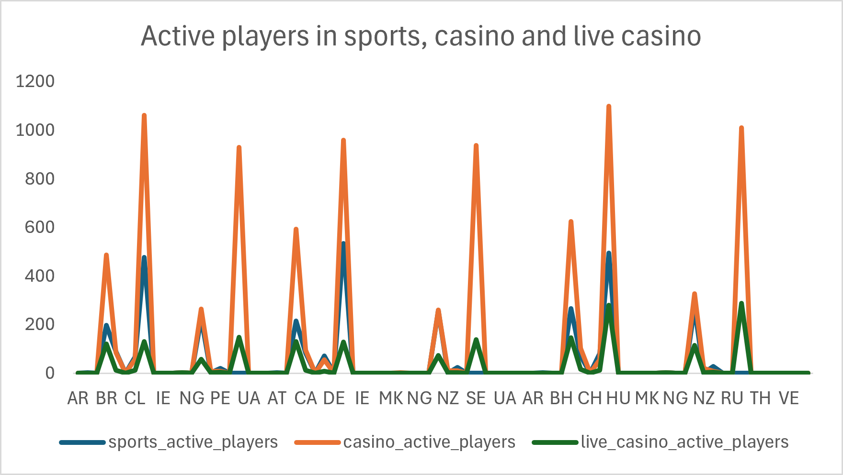
Casino Drives Engagement Across Nearly Every Market
Key Insight:
Across almost every market with meaningful volume, HU, CL, TH, DE, SE, UA casino active players outpace sports and live casino active players by 3-5x. Sports and live casino only approach casino volume in a handful of markets (BR, DE, CH, HU).
Casino is the primary engagement driver, not sports betting. Product investment and cross-sell campaigns should lead with casino, using it as the on-ramp into sports and live casino.

Slide 5
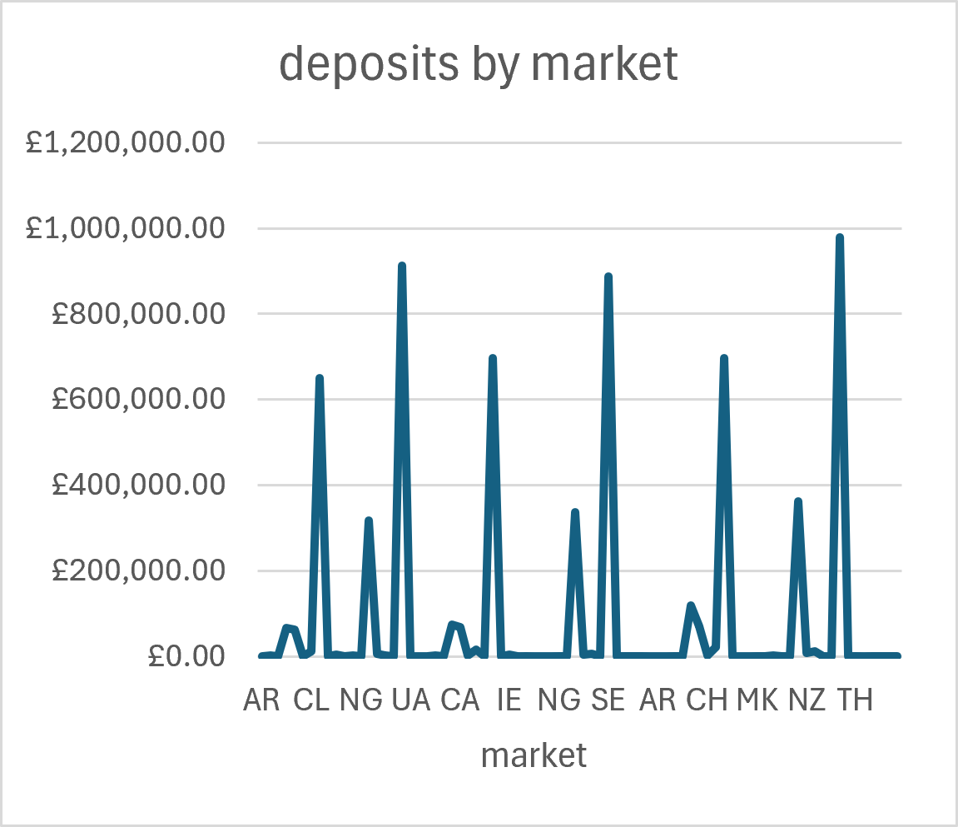
Which Markets Produce the Highest Deposit Value
Key Insight:
Thailand (TH) leads deposit value at ~£985k, closely followed by Ukraine (UA, ~£915k) and Sweden (SE, ~£885k). Notably, TH and UA rank far higher on deposit value than on active player count signalling a smaller but higher-value player base in these markets.
Active player count alone understates market value. TH and UA deserve dedicated retention focus given their outsized deposit value relative to player numbers.

Slide 6
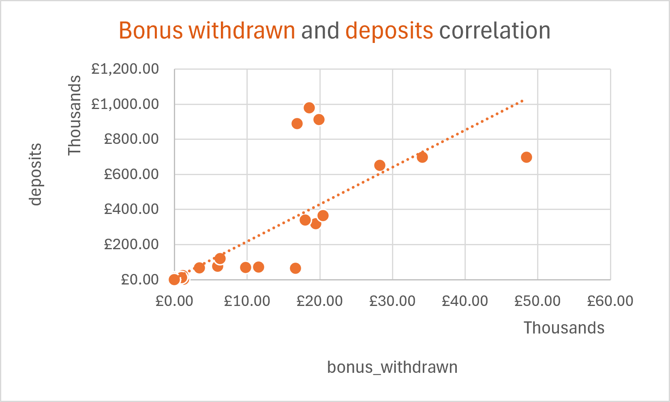
Which Markets Produce the Highest Deposit Value
Key Insight:
Bonus withdrawn and deposits show a broadly positive relationship, consistent with bonus spend supporting deposit activity. But several markets sit well off the trendline: three points near £17-20k bonus withdrawn generate £880k-980k in deposits, far above trend, while one market at ~£48k bonus withdrawn under-delivers relative to its spend.
Bonus spend is not uniformly efficient. The over-performing markets show where bonus budget converts best; the under-performer is a candidate to review or reallocate.

Slide 7
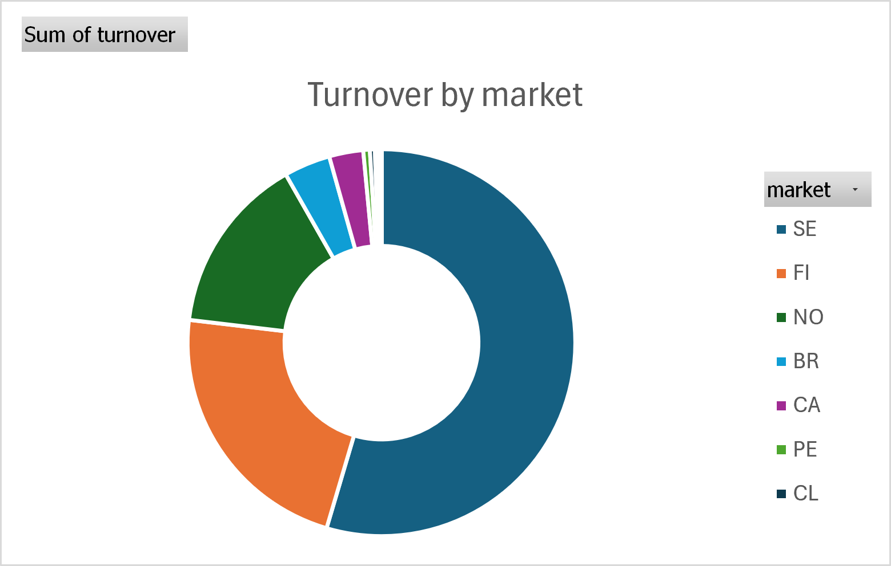
Turnover Is Concentrated in the Nordic Markets
Key Insight:
Sweden (SE) and Finland (FI) together account for roughly 80% of total turnover (~50% and ~30% respectively), with Norway (NO) a distant third at ~13%. All remaining markets combined make up a small single-digit share.
Turnover concentration in SE/FI is even sharper than the active-player concentration in DE/SE the two lenses point to different top markets, and both deserve dedicated commercial attention rather than a one-size-fits-all approach.

Slide 8
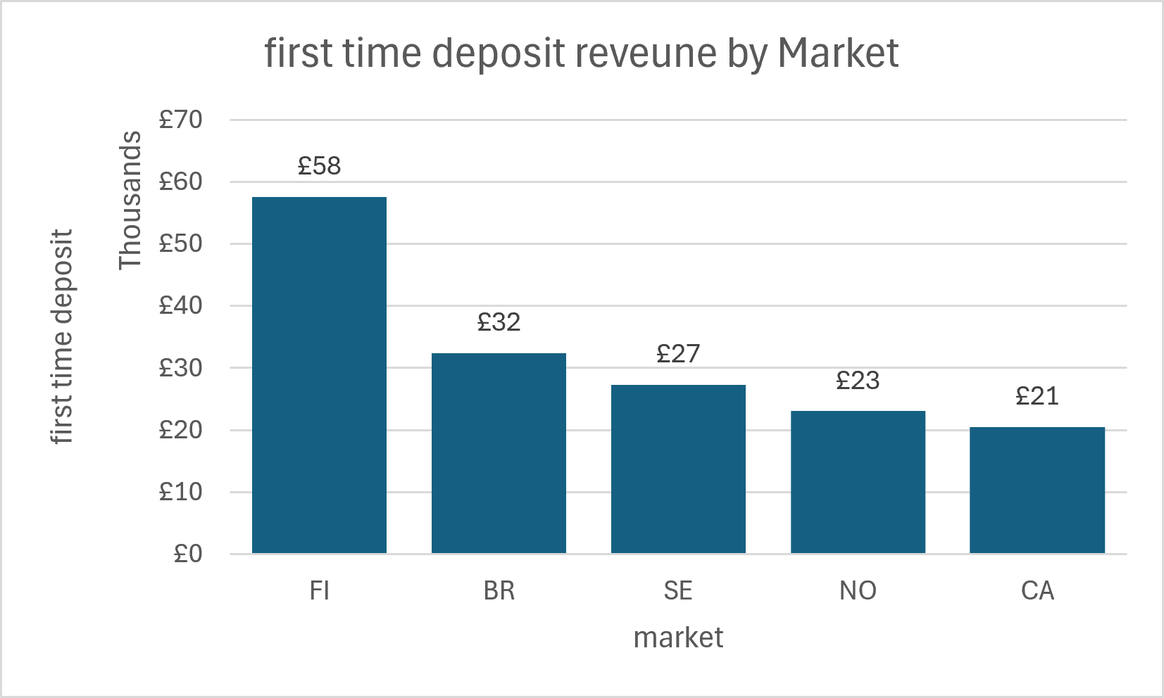
Where First-Time Depositor Revenue Is Strongest
Key Insight:
Finland (FI) leads first-time deposit revenue at £58k, nearly double Brazil (BR, £32k) and well ahead of Sweden (SE, £27k), Norway (NO, £23k) and Canada (CA, £21k).
FI's new depositors bring higher upfront value than any other market’s, a strong candidate market to prioritise for acquisition spend, since new players there are worth more from day one.

Slide 9
